Slide 1
Homework 04
Counting Objects in an
Image

Slide 2
Deadlines
Complete Homework Due: December 9 by Midnight

Slide 3
Counting Objects in an Image
Designing and implementing a system, in either C or C++, to label and count the number of objects in a given image
Each image consists of a number of pixels, and initially all pixels will have one of two labels, 0 and 1
0 is considered a background pixel while a 1 represents a pixel that is part of an object
Your system will apply, over multiple iterations, the same label to pixels that are connected to form objects, and then count the number of objects for a given image

Slide 4
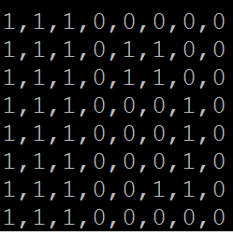
Input file
All input files will be a comma delimited matrix of 1 and 0s that represent the input image
The dimensions of the matrix will be always square but size will vary

Slide 5
To-Do
Allow the user to input the name of the file describing the image
Initially, all pixels will be labelled 0 or 1
Every pixel needs to be examined. One by one
starting at the top left corner, and moving linearly to the bottom right corner
There will be total Two passes

Slide 6
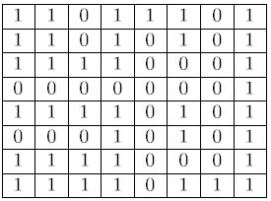

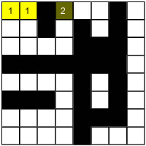
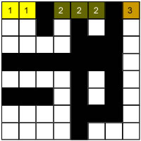
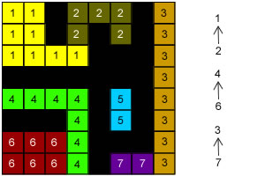
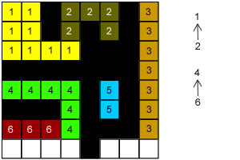
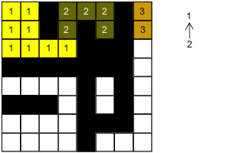
Label all the pixels
First Pass
(a) Image
(b) Start from top left with new label
(c) Pixel(1,4) has no pixel above and left is a background. Create a new label 2
(d) Pixel(1,8) has no pixel above and left is a background. Create a new label 3
(f) Completing row 7, new label 6
(e) Pixel(3,4) has both above and left label. Choose the smallest label
Store larger label as a child of smallest
(g) First pass complete

Slide 7

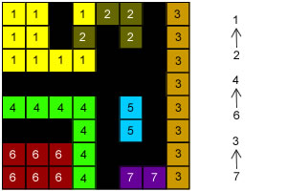
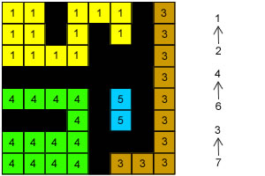
Image Labelling Procedure
Second Pass
(a) Label after First Pass
(c) The Final result
(b) Converting a '2' into a '1‘
Start again from top left with new label:
checks the data structure for the label '1‘
‘1' is not a child of any other labels
For pixel (1,4),checks the data structure for '2'
It notices that '2' is a child of '1'
Then, it checks for '1‘ (root)
It replaces the label of (1, 4) with '1'

Slide 8
First pass
If a pixel is a background pixel (its label is 0), simply ignore it and move on to the next pixel
Otherwise, check the label of the pixel above and to the left of the current pixel if they exist. There may be 3 possible cases:
Case 1: If the top and left pixels are background pixels or do not exist, create a new label
Case 2: If one is a background pixel or does not exist and the other has a label, the current pixel will be labeled the same as the labeled pixel
Case 3: If both the above and left pixels have different labels, assign the current pixel the smallest label and store that there is a relationship between the two labels. This will be used in the second pass.

Slide 9
Second Pass
Consider the information you saved during the first pass for case 3. Any time you find a pixel whose label has a relationship with another label, assign the current pixel the smaller value of the relationship
After both passes are complete, count the number of unique labels. This represents the number of objects in the image
Output the image with the new labels and the count of the number of objects in the image

Slide 10
Sample Output
Input
1,1,1,0,0,0,0,0
1,1,1,0,1,1,0,0
1,1,1,0,1,1,0,0
1,1,1,0,0,0,1,0
1,1,1,0,0,0,1,0
1,1,1,0,0,0,1,0
1,1,1,0,0,1,1,0
1,1,1,0,0,0,0,0
1 1 1 0 0 0 0 0
1 1 1 0 2 2 0 0
1 1 1 0 2 2 0 0
1 1 1 0 0 0 3 0
1 1 1 0 0 0 3 0
1 1 1 0 0 0 3 0
1 1 1 0 0 3 3 0
There are 3 objects in this image.
The maximum length of an object in this image is 21 pixels
Output

